Slide 1

Predicting Housing Market Trends: A Data-Driven Approach to Price Forecasting
Course :- DSCI 8950 Presented To:- Lochana Palayangoda
Presented By:- Amarnath Kommineni Kavya Gurram Sandeep Borwal Vikas Kumar Reddy Buchammagari

Slide 2
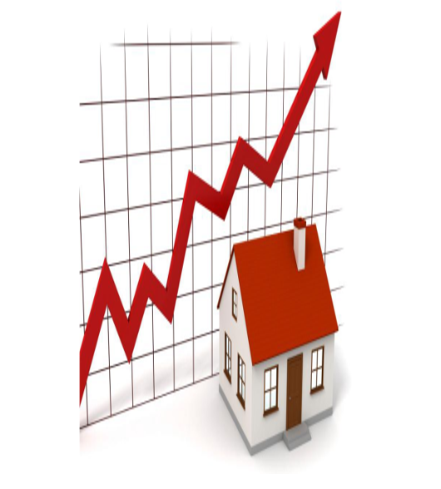
Problem Statement
How accurately can we predict housing prices using machine learning models based on property features and market conditions.
Identify most important features affecting price?
Notes:
Introduction
The real estate market significantly impacts the global economy.
Housing prices depend on multiple factors like location, size, and market trends.
Traditional pricing methods are subjective, time-consuming, and prone to errors.
Problem Statement
Estimating property values accurately remains a challenge.
Current appraisal methods lack efficiency and objectivity.
Solution: Machine Learning Model
Leverages historical data to identify patterns and correlations.
Improves accuracy by reducing human bias in price estimation.
Provides quick, data-driven predictions based on market conditions.
Project Goal
Develop a machine learning model to predict housing prices.
Use key property attributes and economic indicators for training.
Enhance reliability and efficiency in real estate pricing.

Slide 3
Objective of the Study
Leverages historical data to identify patterns and correlations.
Improves accuracy by reducing human bias in price estimation.
Provides quick, data-driven predictions based on market conditions.
Develop a machine learning model to predict housing prices.

Slide 4
📊 Data Overview
📈 Supplementary Economic Indicators:
Personal Income
Population Growth
Per Capita Income
Economic data has been merged with Zillow records for enhanced analysis.
📊 Data Overview
🏠 Property Types Analyzed (Zillow Dataset):
Single Family Homes – 10.5K records
Two Bedroom Homes – 10.5K records
Three Bedroom Homes – 10.5K records
All Homes (General) – 10.5K records
Condos – 10.5K records
Each property type dataset contains approximately 10,500 records.
🌎 Granularity:
County-Level Analysis
🗓️ Time Frame:
2020 to 2024
📚 Data Sources:
Zillow Real Estate Dataset
U.S. Bureau of Economic Analysis

Slide 5
Data Cleaning & Preprocessing
DataSet
Files Included
Counties-level per capita income and housing values
Zillow Home Value Index
Population, Income data
Merging files
Meaningful Names
Additional Features
Final Formatting
Zillow Dataset - multiple files with real estate and per capita income data.
Rename columns to make meaningful names
Adding longitude,latitude,FIPS
Format data types & Removed missing values
Merging Files for different house types
Notes:
Zillow Dataset contains multiple files with real estate and per capita income data.
Files Included:
Counties-level per capita income and housing values
Zillow Home Value Index (ZHVI) for 2-bedroom and 3-bedroom homes
Income data at the county and zip code levels
Merging the files to make a common file
Rename columns to make menaingfull names
Adding longitude,latitude,FIPS to show for maps
Added data for Per_Capita_Income_Growth, Population_Growth, Personal_Income_Growth
Removed missing values

Slide 6
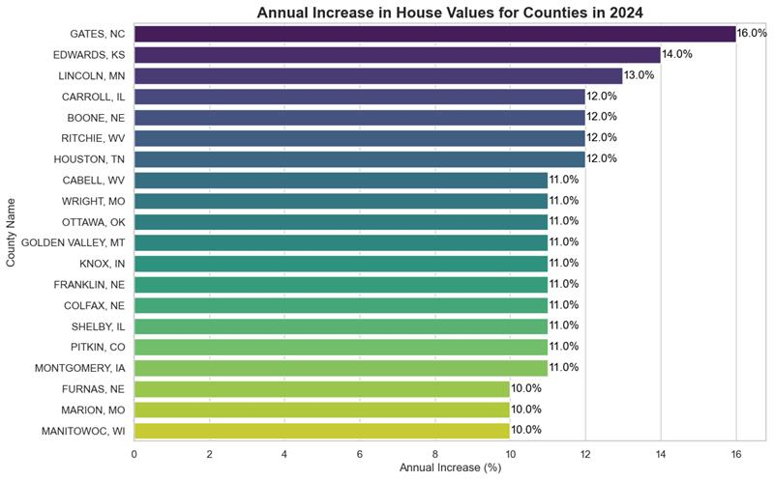
Annual Increase in House Values
Top Performers:
GATES, NC: Leading with a 15.0% increase.
EDWARDS, KS: Close behind with a 14.0% increase.
LINCOLN, MO and CARROLL, NE: Both showing a 12.0% increase.
Notes:
The bar chart titled "Annual Increase in House Values for Counties in 2024" illustrates the percentage increase in house values across various counties. Here are the key points:
Top Performers:
GATES, NC: Leading with a 15.0% increase.
EDWARDS, KS: Close behind with a 14.0% increase.
LINCOLN, MO and CARROLL, NE: Both showing a 12.0% increase.
Moderate Increases:
BOONE, NC: 11.0%
HARLAN, WI: 10.0%
WORTH, IA and CAMBEL, WV: Both at 9.5%
WIRT, OH: 9.2%
Lower Increases:
ORANGEVILLE, NY: 8.7%
GOLDEN VALLEY, MT: 8.5%
KNOX, IN: 8.2%
FRANKLIN, ME: 7.6%

Slide 7
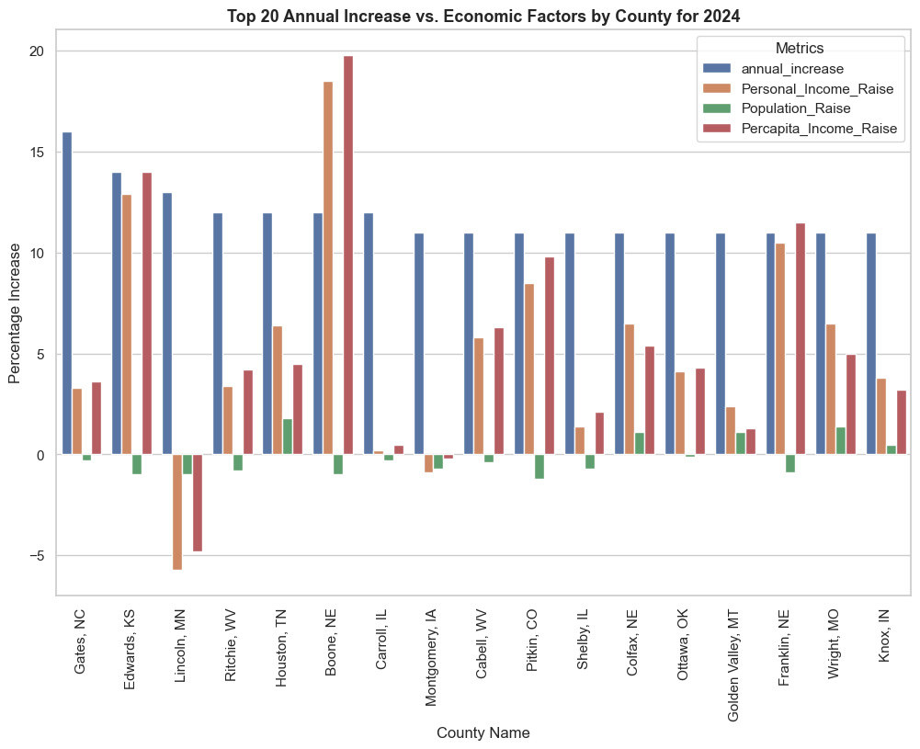
Annual Increase Vs Economic Factors
The overall trend indicates that counties with higher median income rates and population growth tend to have higher annual increases in house values.

Slide 8
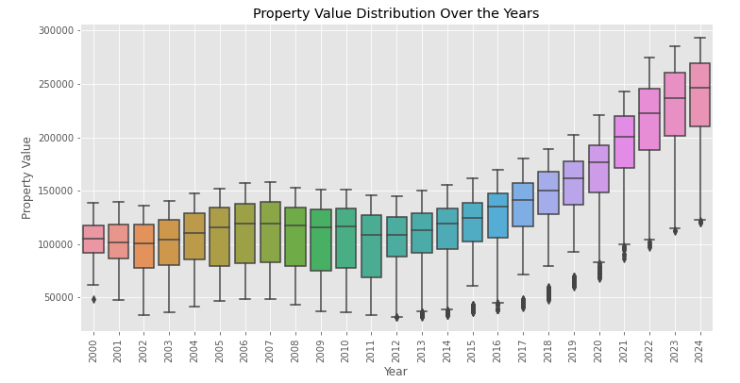
Property Value Distribution Over Years
Observations:
Rising Median Values: Median property values have risen consistently over the period, indicating an overall upward trend in property prices.
Variability: There is noticeable variability in property values each year, with some years showing wider IQRs than others.
Outliers: Present in most years, suggesting that there are some properties with significantly higher or lower values compared to the majority.
Notes:
Increasing Property Values: Property values have generally increased over time from 2000 to 2024.
-->Variability: There is noticeable variability in property values each year, with some years showing wider IQRs than others.
-->Rising Median Values: Median property values have risen consistently over this period, indicating an overall upward trend in property prices.
-->Outliers: Present in most years, suggesting that there are some properties with significantly higher or lower values compared to the majority.

Slide 9
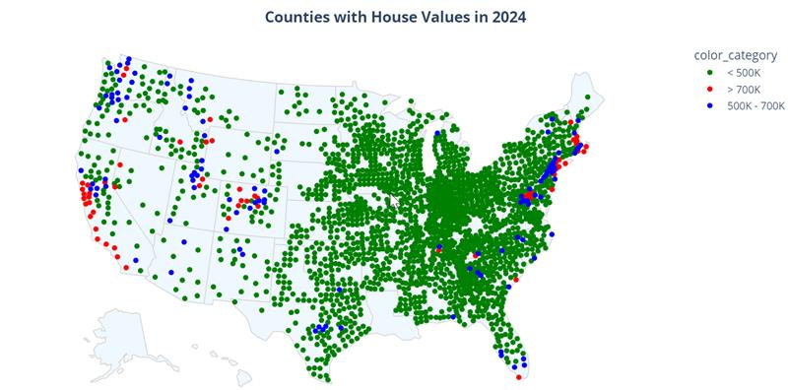
Counties house Values 2024

Slide 10
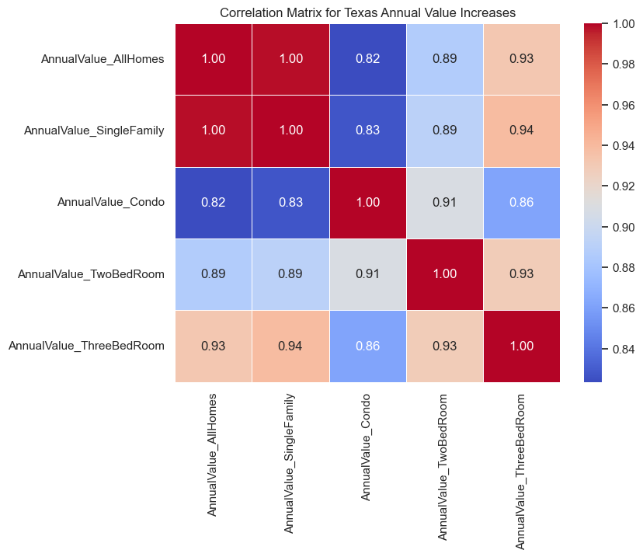
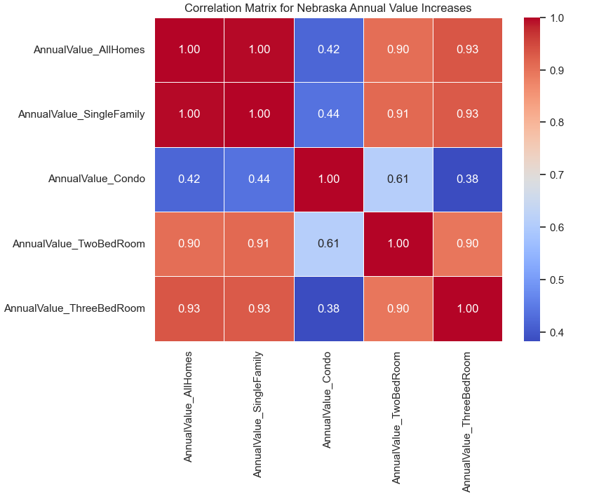
Correlation Matrix for Nebraska/Texas Annual Value Increases
Nebraska:
Increases in property values for different types of properties (all items, single-family, condos, two-bedroom) are strongly related.
Market trends affecting one property type are likely to influence others similarly.
Texas:
Although the full matrix is not visible, it is expected to show similar correlations.
Indicates consistent market behavior across different property types.
Notes:
Summary:
Nebraska: The correlations indicate that increases in property values for different types of properties (all items, single-family, condos, two-bedroom) are strongly related. This suggests that market trends affecting one property type are likely to influence others similarly.
Texas: Although the full matrix is not visible, it is expected to show similar correlations, indicating consistent market behavior across different property types.

Slide 11
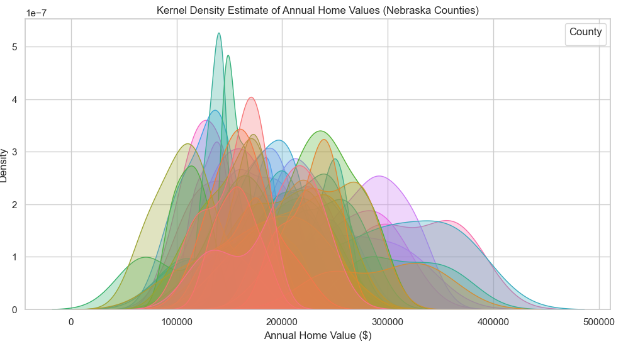
Kernel Density Estimate of Annual Home Values (Nebraska Counties)
Notes:
Summary:
Distribution Patterns: The KDE plot shows how home values are distributed across different counties. Some counties have a higher concentration of home values in certain ranges, indicating more uniform property values.
Density Peaks: Peaks in the curves indicate the most common home values within each county. Higher peaks suggest a larger number of homes within that value range.
Variability: The spread of the curves shows the variability in home values. Wider curves indicate more variability, while narrower curves suggest more consistent home values.
Comparison Across Counties: The plot allows for comparison of home value distributions across counties, highlighting differences and similarities in property value trends.
This KDE plot helps in understanding the distribution and density of home values across various counties in Nebraska, providing insights into regional housing market trends.

Slide 12
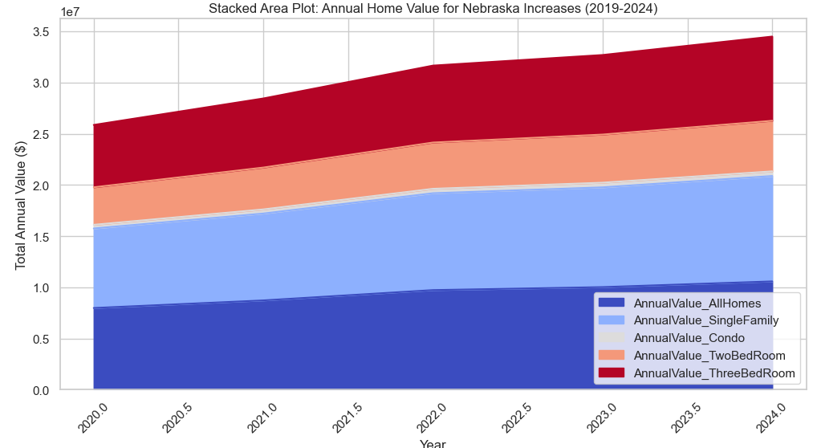
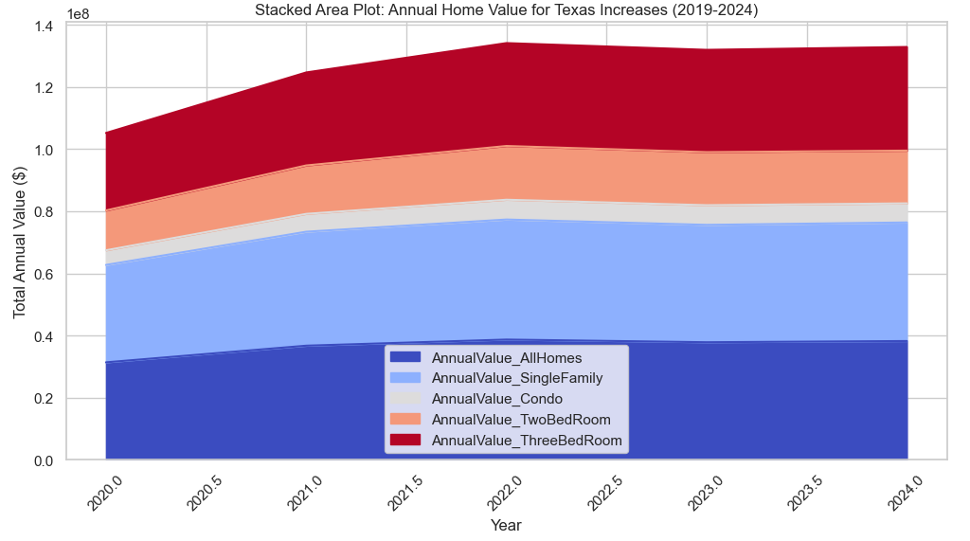
EDA with House Values across all Categories over Years
Notes:
Stacked Area Plot for Nebraska This Stacked area Plot for Nebraska shows consistent upward trend in annual home values across all categories.
Dominance of All Homes and Single Family Homes as they form base of stack and show most significant growth.
Also shows significant contribution from Two and Three Bed rooms.Condo category shows least amount of growth compared to other categories.
Slope of stacked area suggesting steady and sustatined growth rate in home values.

Slide 13
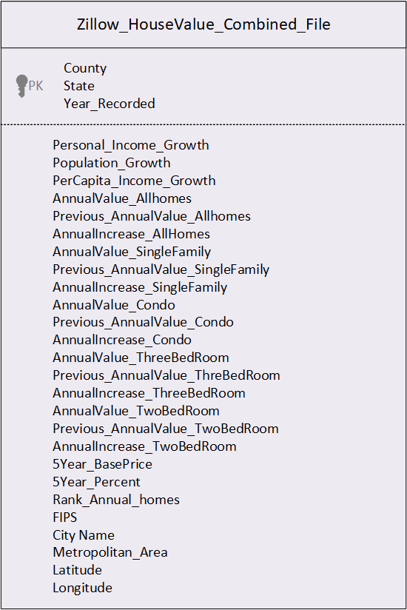
Zillow House Price Model Dataset
Exploratory Data Analysis(EDA)
Notes:
As part of Exploratory Data Analysis ; we read the Zillow Home Value Index data sets for AllHomes, Single Family , Condo, TwoBedRoom, ThreeBedRoom .
Build Annual Increase for each of County for each Year.
Build 5 Year Increase for each of County for each Year.
Idnetified Personal income Growth , Population Growth , Percapita Income Growth for each county to every year . Performed Percapita Increase from year to Year.
Build Rank for each County and performed Exploratory Data Analysis and produced Combined Dataset.

Slide 14

Time Series Models

Slide 15
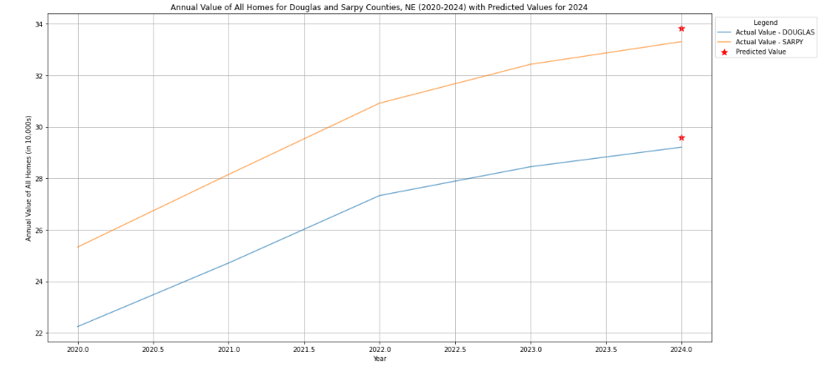
ARIMA (p,d,q)

Slide 16
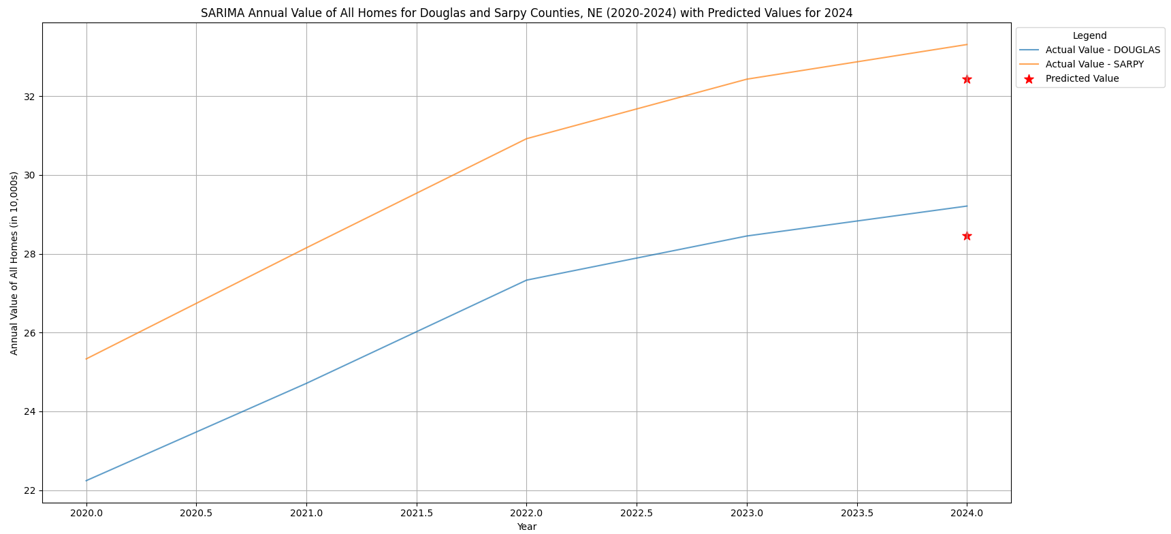
SARIMA(p, d, q)(P, D, Q, s)
Notes:
SARIMA(p, d, q)(P, D, Q, s): AR(p): Autoregressive component of order p MA(q): Moving average component of order q I(d): Integrated component of order d Seasonal AR(P): Seasonal autoregressive component of order P MA(Q): Seasonal moving average component of order Q Seasonal I(D): Seasonal integrated component of order D s: Seasonal period

Slide 17
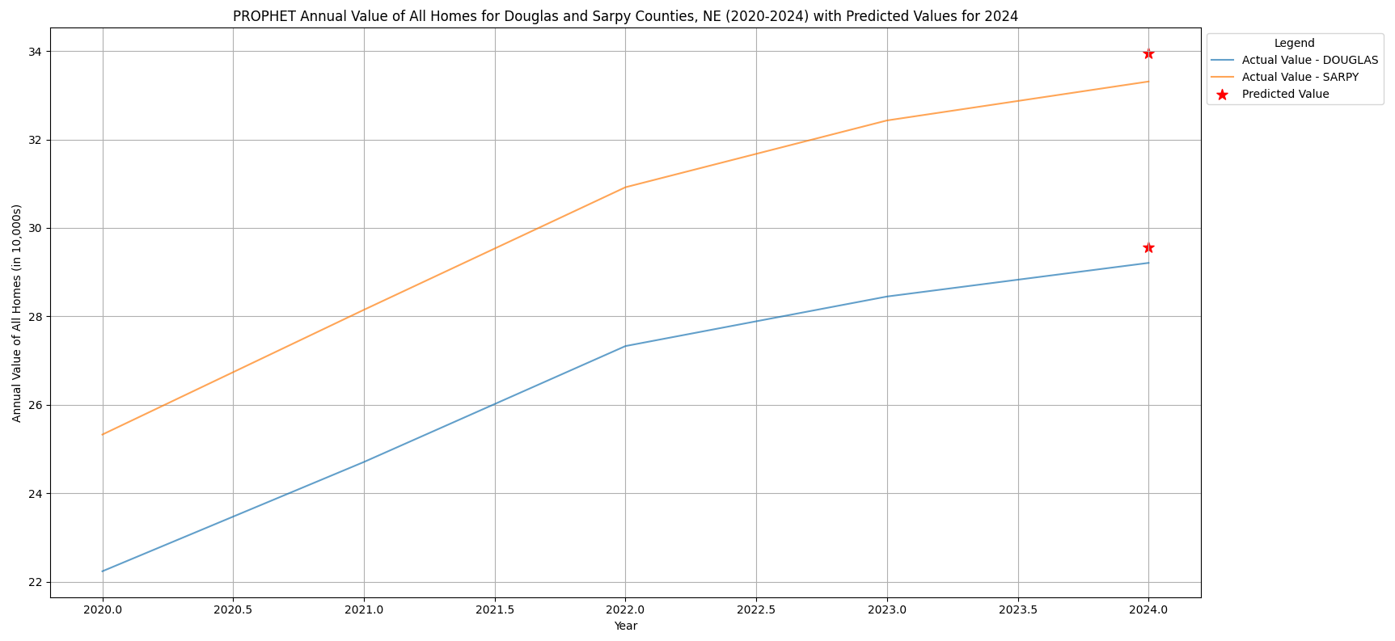
PROPHET

Slide 18
LSTM
Key Parameters:
Best parameters for AnnualValue_AllHomes:
input_size = 1
hidden_size = 50
num_layers = 2
output_size = 1
seq_length = 12
num_epochs = 50
learning_rate = 0.001
batch_size = 32

Slide 19
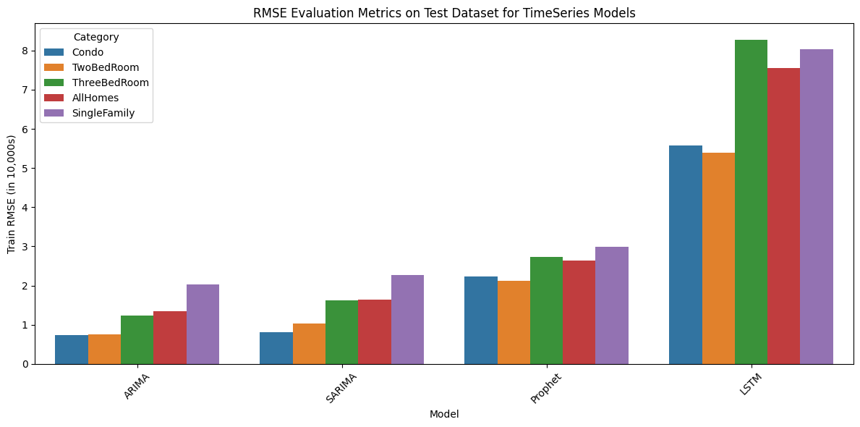
TIME Series Models

Slide 20
Machine Learning Models

Slide 21
Random Forest
Key Parameters:
Best parameters for AnnualValue_AllHomes:
'bootstrap': True,
'max_depth': None,
'max_features': 'sqrt’,
'min_samples_leaf': 1,
'min_samples_split': 2,
'n_estimators': 100
Notes:
Random Forest for Regression uses Random Forest Regressor For real estate prediction, Random Forest excels at modeling complex non-linear relationships between features, handling interactions between location and economic indicators, managing outliers in housing data, and capturing both local and regional market trends.

Slide 22
XGBOOST
Key Parameters:
Best parameters for AnnualValue_AllHomes:
'colsample_bytree': 0.8
'gamma’: 0
'learning_rate': 0.1
'max_depth’: 6
'n_estimators': 100
'subsample': 0.8
Notes:
Random Forest for Regression uses Random Forest Regressor For real estate prediction, Random Forest excels at modeling complex non-linear relationships between features, handling interactions between location and economic indicators, managing outliers in housing data, and capturing both local and regional market trends.

Slide 23
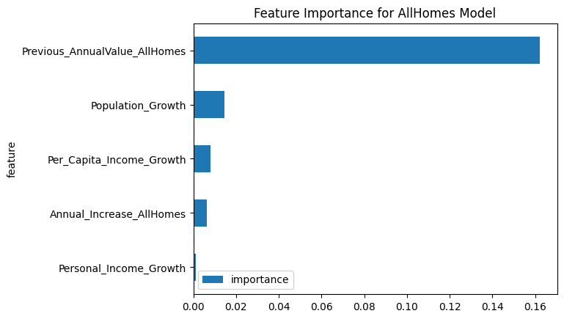
XGBOOST
XGBoost (Extreme Gradient Boosting) is a powerful machine learning algorithm that is part of the gradient boosting family. XGBoost builds an ensemble of decision trees, where each new tree corrects the errors made by the previous trees.
XGBoost has various hyperparameters (e.g., learning rate, number of estimators, maximum depth, etc.) that are fine-tuned to improve model performance. This allows it to fit the house price prediction model optimally.
Category | Train RMSE | Test RMSE | Train MAE | Test MAE
AllHomes | 4.4 | 33 | 2.1 | 4.4
Condo | 19 | 24.3 | 12.6 | 16.1
SingleFamily | 20 | 43.7 | 8.7 | 10
ThreeBedRoom | 19 | 31.2 | 10 | 11.6
TwoBedRoom | 13.6 | 17 | 7.8 | 9.6
Notes:
subsample=0.8: Uses 80% of the training data for each tree to reduce overfitting.
n_estimators=100: Builds 100 trees (or boosting rounds) in the model.
max_depth=6: Sets the maximum depth of each tree to 6 levels, balancing model complexity.
learning_rate=0.1: Controls how much each tree influences the model, with smaller values requiring more trees.
gamma=0: No additional regularization is applied to the tree-building process.
colsample_bytree=0.8: Uses 80% of the features to build each tree, helping to prevent overfitting.
random_state=42: Ensures reproducibility of results.

Slide 24
XGBOOST + AR
Key Parameters:
Metric | Value | Reduction
RMSE Before AR Model | 33048.20 | 0.11
RMSE After AR Model | 33048.09
MAE Before AR Model | 4437.30 | -0.23
MAE After AR Model | 4437.53
Notes:
Random Forest for Regression uses Random Forest Regressor For real estate prediction, Random Forest excels at modeling complex non-linear relationships between features, handling interactions between location and economic indicators, managing outliers in housing data, and capturing both local and regional market trends.

Slide 25
Light Boost
Key Parameters:
Best parameters for AnnualValue_AllHomes:
'colsample_bytree': 0.8,
'learning_rate': 0.1,
'max_depth': 6,
'n_estimators': 100,
'reg_alpha': 0,
'reg_lambda': 0,
'subsample': 0.8
Notes:
LGBM (Light Gradient Boosting Machine) is a powerful machine learning algorithm in the gradient boosting family, similar to XGBoost.
It builds an ensemble of decision trees iteratively, where each tree corrects errors from the previous one.
Unlike XGBoost, which uses depth-first growth, LightGBM grows trees leaf-wise, selecting the leaf with the highest loss reduction.
LightGBM natively handles categorical features, unlike XGBoost, which requires manual encoding.

Slide 26
LASSO
Key Parameters:
Best parameters for AnnualValue_AllHomes:
'alpha': 10,
'max_iter': 1000,
'tol': 0.001
Notes:
LASSO performs both feature selection and regularization in order to enhance the prediction accuracy and interpretability of the resulting model.

Slide 27
LASSO + AR
Key Parameters:
Best parameters for AnnualValue_AllHomes:
'alpha': 10,
'max_iter': 1000,
'tol': 0.001
Notes:
LASSO performs both feature selection and regularization in order to enhance the prediction accuracy and interpretability of the resulting model.

Slide 28
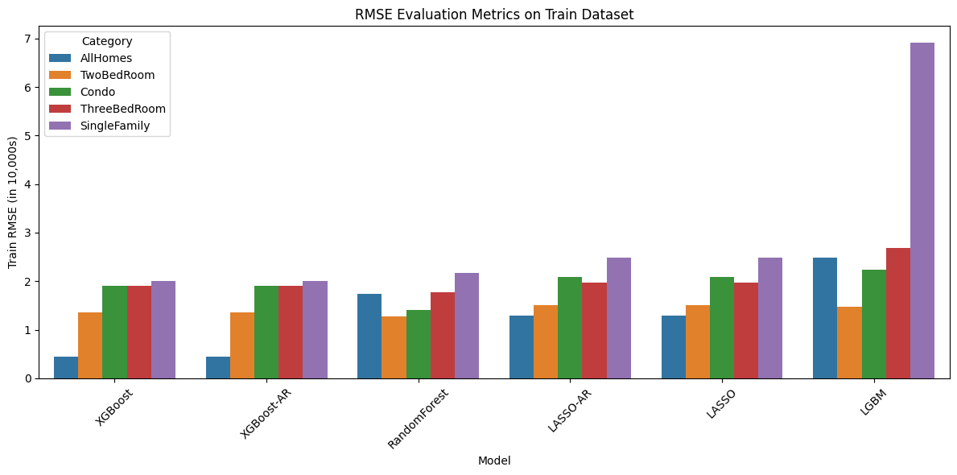
Model Evaluation on Train Data

Slide 29
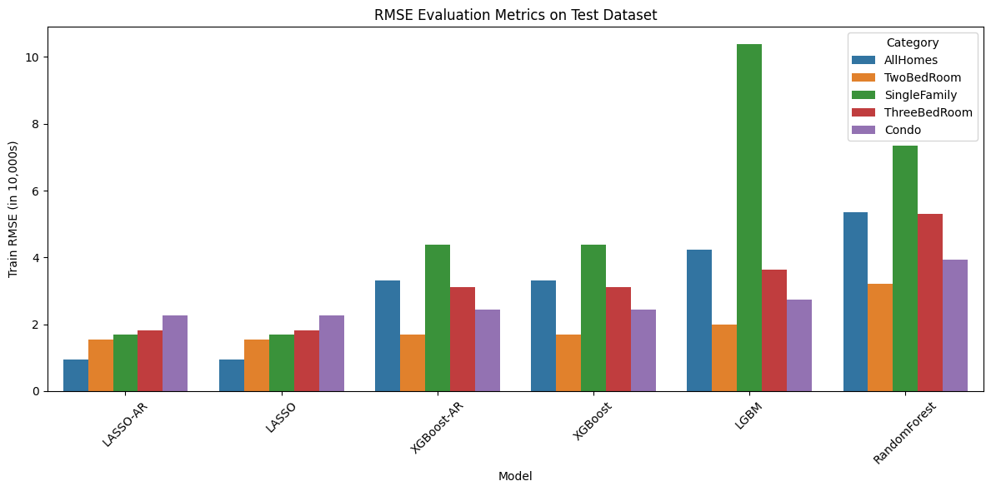
Model Evaluation on Test Data

Slide 30
MODEL SELECTED
XGBoost has best RMSE on Train dataset.
LASSO - AR Model performed better with best RMSE on Test Dataset
Conclude LASSO with Auto regressive model performed better all models.

Slide 31
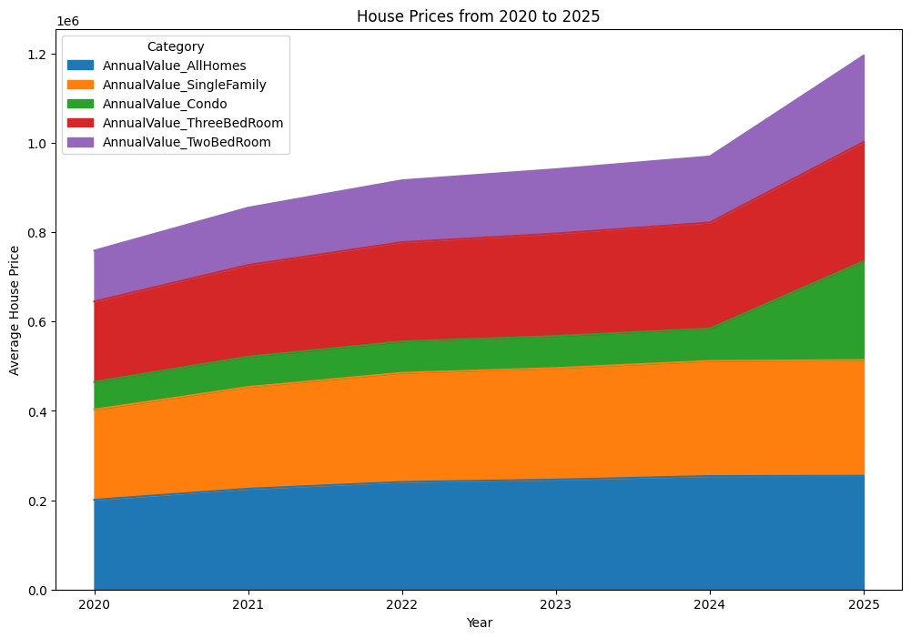
Predictions including 2020 to 2025 across all categories
Notes:
shows the projected housing prices from 2020 to 2025 across all categories. This stacked area chart gives us a comprehensive view of how different property types contribute to the overall market.
What's fascinating here is the acceleration we see around 2024-2025, where prices appear to increase at a faster rate than the more gradual growth from 2020-2023. Two-bedroom properties (shown in purple at the top) show particularly strong growth projections.
Single-family homes maintain the largest portion of the market value throughout the period, as shown by the substantial orange section. Meanwhile, condos (in green) show steady but more modest growth compared to other categories.
The overall upward trajectory across all categories suggests our models are predicting continued strength in the housing market through 2025, with the average price reaching approximately $1.2 million by the end of our projection period.

Slide 32
Conclusion
Data Cleaning & Preprocessed:
Time Series ModeLs:-
ARIMA SARIMA
PROPHET
LSTM
Machine Learning ModeLs:-
XGBoost
XGBoost + AR
RandomForest
LGBM
LASSO
LASSO+AR
Model chosen as
LASSO + AR
Machine learning significantly improves housing price predictions compared to traditional methods.
Notes:
Dataset Preprocessed: Comprehensive data cleaning and preprocessing steps were undertaken to ensure data quality. Machine Learning Models Implemented: Various models including XGBoost, LightGBM, Lasso Regression, and Support Vector Regression were applied.

Slide 33

Instructor Feedback Comments
SARIMA or Prophet models should have been discussed as this is a time series data set. --Added
Missing data and outlier imputations are very questionable.– Imputation removed
R&D for the Final Presentation:-
Apply Boosting Techniques with ARIMA methods – Added
Develop Deep Learning Models for the Data Set –Done
Need to explain how your approaches are different from Kaggle
Difference from Kaggle
we are using live data sets from Zillow and us bureau.
Kagle solutions have datasets which have many features which we could not find in the Zillow data set
We are using latest datasets whereas Kaggle are using 2016 to 2020 datasets
We have used many models and as per instructor feedback like XGBoost +AR and LSTM models .

Slide 34
Future Scope / Enhancements
Real-Time Data Integration: Connect to live feeds from Zillow or economic data sources.
Geospatial Analysis: Add map-based visualizations using GIS tools for deeper insights.
Model Deployment: Package the best model into a dashboard or API for real-time predictions.
Macro Factors: Include interest rates, mortgage rates, and inflation data for richer forecasting.
Multi-model Ensemble: Combine LSTM, XGBoost, and LightGBM for hybrid predictions.

Slide 35

References
Housing Data - Zillow Research
Zillow Home Value Index (ZHVI)
Zillow Home Value Forecast (ZHVF)
USA State map
City Latitude and Longitude.
U.S. Bureau of Economic Analysis – https://www.bea.gov/
U.S. Census Bureau – https://www.census.gov/

Slide 36

Thank You

